Slide 1
Introduction to Big Data Systems
Lecture 9. Graph Computing (push/pull)
Wenguang CHEN
Tsinghua University

Slide 2
Where are we now…
Out of core
Shentu
SC’18
In
Mem
Single
Machine
Multiple
Machine

Slide 3
Outline
Top down vs. bottom up(push/pull)
Distributed push/pull(gemini)
Very large graph processing(Shentu)
Graph Mining(Arabsque and Automine)

Slide 4
TOP DOWN VS. BOTTOM UP

Slide 5
BFS Example
1
3
2
4
0
9
5
7
6
8
1st iteration
Notes:
Let’s start from the dual-mode design, using BFS from vertex 0 on this 10-vertex sample graph as an example.
The idea was first proposed in Ligra and adopted later in several other shared-memory systems, based on the observation that DIFFERENT active edge set densities call for DIFFERENT PROCESSING MODELS.
For example, in the first iteration, only vertex 0 is *active*, with four edges forming the *active edge set*. The number of active edges RELATIVE to the TOTAL number of edges is under a certain PREDEFINED THRESHOLD, hence we consider the graph SPARSE.
Under sparse mode, we do *push-style* computation, which propagates vertex states along *outgoing* edges. The reason is that we ONLY need to access outgoing edges from *active vertices*. The *down side*, is that when multiple vertices are active, CONCURRENT NEIGHBOR STATE UPDATES need locks or atomic operations for correctness.

Slide 6
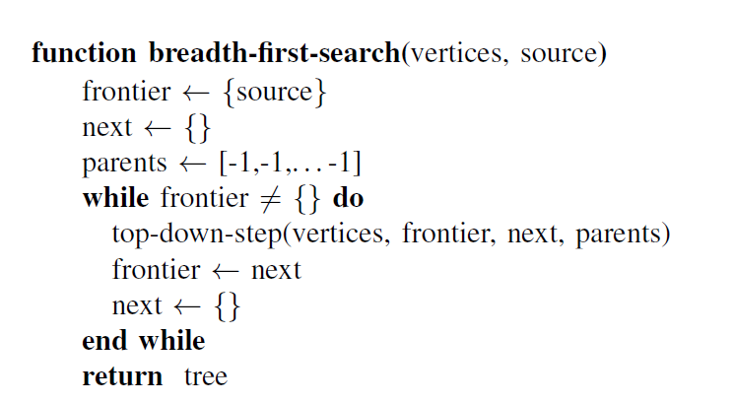
Breath-first-search

Slide 7
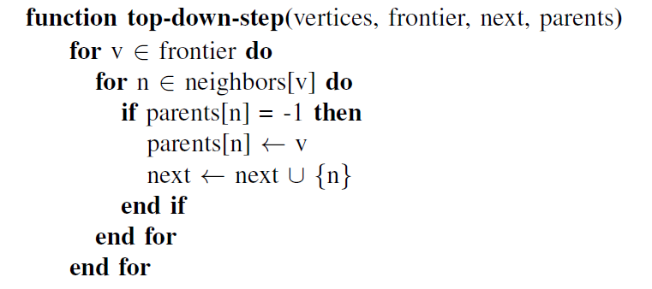

Slide 8
BFS Example （top-down model)
Active edge set
1
3
Active vertex set
2
4
0
9
5
7
Selective scheduling: only access out-edges
from active vertices
6
8
1st iteration
Locks/atomic operations
required for correctness
of concurrent updates
Notes:
Let’s start from the dual-mode design, using BFS from vertex 0 on this 10-vertex sample graph as an example.
The idea was first proposed in Ligra and adopted later in several other shared-memory systems, based on the observation that DIFFERENT active edge set densities call for DIFFERENT PROCESSING MODELS.
For example, in the first iteration, only vertex 0 is *active*, with four edges forming the *active edge set*. The number of active edges RELATIVE to the TOTAL number of edges is under a certain PREDEFINED THRESHOLD, hence we consider the graph SPARSE.
Under sparse mode, we do *push-style* computation, which propagates vertex states along *outgoing* edges. The reason is that we ONLY need to access outgoing edges from *active vertices*. The *down side*, is that when multiple vertices are active, CONCURRENT NEIGHBOR STATE UPDATES need locks or atomic operations for correctness.

Slide 9
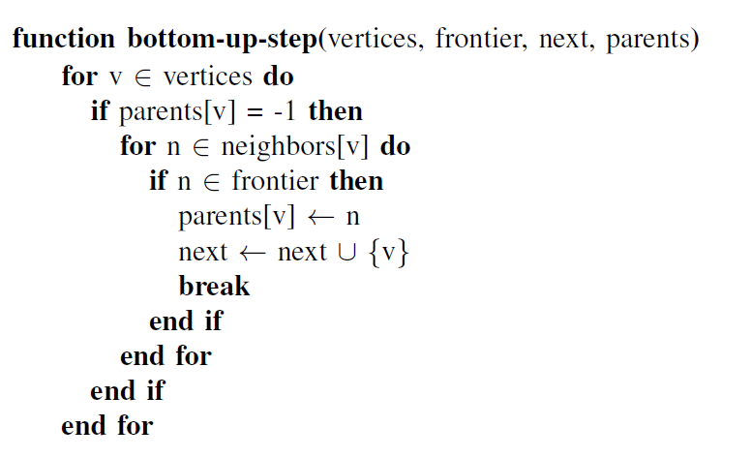
Bottom-up BFS

Slide 10
BFS(Bottom-up mode)
|Active edge set| / |E| > threshold
Dense mode
Pull operations
Active edge set
1
3
Limited
selective scheduling
2
4
0
9
5
7
6
8
Vertices pulling along in-edges
Contention-free updating
2nd iteration
Notes:
In the second iteration, there are *ten* active edges, meeting the bar for DENSE mode, where we do *pull-style* computation.
Here, each *unexplored* vertex pulls along *incoming* edges to update its OWN state. This reduces contention since *only one writer per vertex* is launched.
The downside, of course, is that we don’t get to do *selective scheduling* so easily as with push mode. See, here vertex 9 does not have anything new YET from its neighbors, but it has to pull anyway.
This is why it is better to do push at the sparse mode, and pull at the dense.

Slide 11
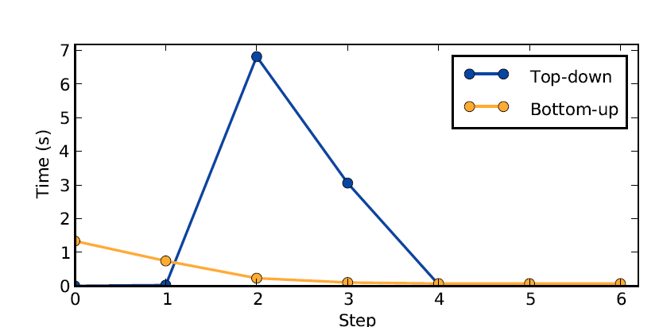
Motivation for a hybrid algorithm
Sample search on kron27 (Kronecker 128M vertices with 2B undirected edges) on the 16-core system
Beamer, S., Asanović, K., & Patterson, D. (2013). Direction-optimizing breadth-first search. Scientific Programming, 21(3-4), 137-148.

Slide 12
Heuristics for mode switch
Dual mode updates proposed in shared-memory systems (Ligra^{[PPoPP ’13]})
|Active edge set| / |E| < threshold
Sparse mode
Push operations
|Active edge set| / |E| > threshold
Dense mode
Pull operations
1
3
2
4
0
9
5
7
6
8
Top-down
Less active edges – sparse – push
Bottom-up
More active edges – dense – pull

Slide 13
GEMINI –Distributed push/pull

Slide 14
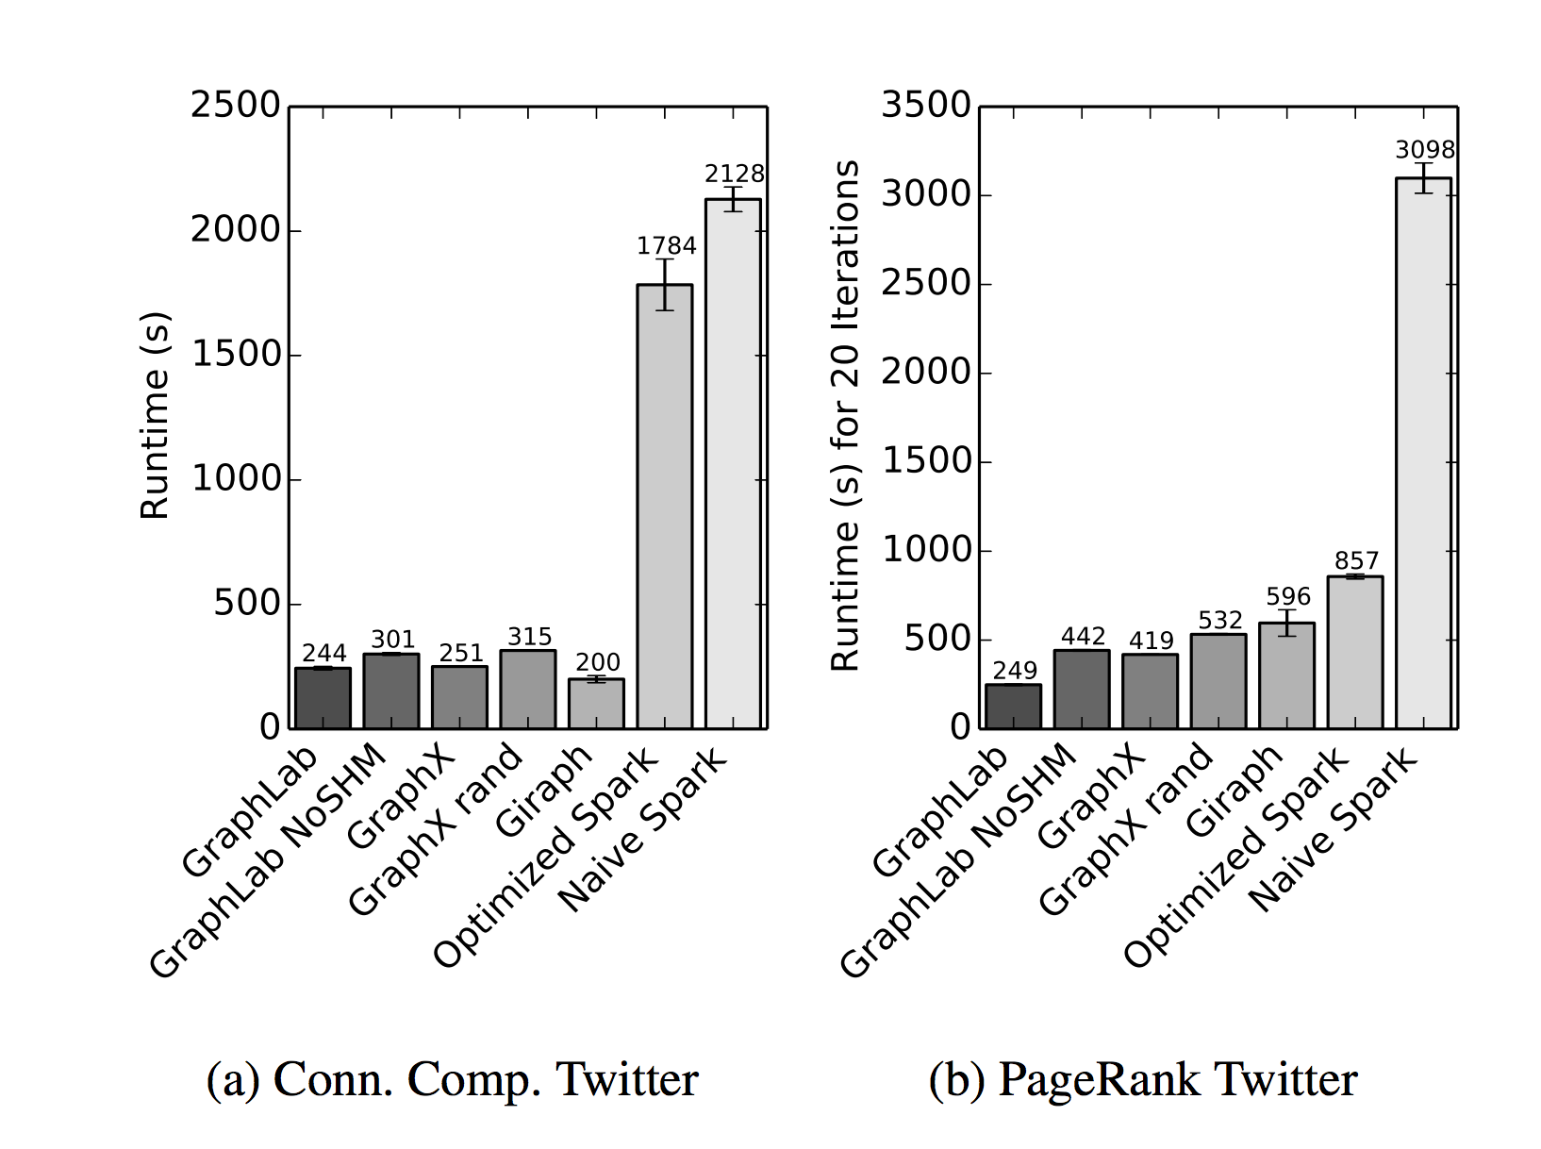
Is PowerGraph/PowerLyra good enough?
10X faster than Naïve Spark
Gonzalez, Joseph E., et al. "Graphx: Graph processing in a distributed dataflow framework." Proceedings of OSDI. 2014.

Slide 15
But still has big potentials
Results on twitter dataset(in seconds)
Distributed systems on 8 nodes

Slide 16
Bottleneck analysis on PowerLyra
common design
Bottleneck in computation!
Profiling existing systems
Nodes System | 1 Galois | 8 PowerLyra
Runtime (s) | 19.3 | 26.9
Instructions | 482G | 6.06T
Memory references | 23.4G | 87.2G
Communication (GB) | - | 38.1
Instructions per cycle | 0.414 | 0.655
L3 cache miss rate | 49.7% | 54.9%
CPU utilization | 96.8% | 68.4%
Far from saturated
for IB EDR (100Gbps)
(38.1*8/2/26.9/8=0.708Gbps)
More instructions
and memory traffic
Distributed overhead
Poorer access locality
Sub-optimal computation
Lower multi-core utilization
20 iterations of PageRank on twitter-2010
(41.7M vertices, 1.47B edges)
Notes:
In this work, we hope to bridge the gap between existing shared-memory and distributed systems, (step) by building a common solution that works *well* across platforms from laptops to typical clusters.
To do this, we first examined the performance of existing graph-parallel systems, by collecting *profiling information* using the perf tool, (Step) This table gives sample results from two leading systems, using 1 and 8 nodes each, running 20 iterations of PageRank on a twitter follower graph.
(Step) The first thing we noticed is that for clusters with today’s high-speed interconnect, Infiniband in this case, network is *definitely* not the bottleneck, as the network bandwidth remains underutilized and communication overlaps well with computation.
So what is the bottleneck then? (step) We notice that the 8-node PowerLyra issues much more instructions and memory references, and has poorer access locality and lower multi-core utilization. These all converge to the conclusion that computation appears to be the bottleneck. The inefficiency comes from multiple sources, and can be classified into two categories: distributed overhead, and sub-optimal implementation of computation components.

Slide 17
We Propose: Gemini
Build scalability on top of efficiency
Avoid unnecessary “distributed” side-effects
Optimize computation on partitioned graphs
Shift of design focus
Designed for distributed, but computation-centric
Modern clusters have fast interconnects
Computation-communication overlap in place
Efficiency optimizations
Adaptive push-/pull-style computation
Hierarchical chunk-based partitioning
Scalability optimizations
Locality-aware chunking
Chunk-based work-stealing
Notes:
We propose Gemini, where the MAIN IDEA is to build scalability *on top of* efficiency, by reducing distributed systems’ side-effects and optimize COMPUTATION on PARTITIONED graphs.
It is designed as a DISTRIBUTED system, but considers the TREND of having high-speed interconnects and that message passing overlaps well with local processing.
It adopts a collection of COMPUTATION-CENTRIC design choices. Details are in the paper and in THIS TALK we only go over a few of them.
On the EFFICIENCY side, we extend adaptive push-/pull-style computation from shared-memory to distributed-memory settings and adopt hierarchical chunk-based partitioning.
On the SCALABILITY side, we perform locality-aware chunking and chunk-based work-stealing for INTER and INTRA-node load balance.

Slide 18
Distributed Dual-mode Computation
Node₀
1
3
2
4
0
9
5
7
6
8
Node₁
Notes:
Gemini extends such dual-mode computation to distributed systems. Suppose we now do the same thing on 2 nodes.
Right now, let’s assume this is how we cut this graph into 2 parts, TOP half assigned to NODE ZERO, and BOTTOM to ONE.

Slide 19
When Distributed to 2 nodes
1
3
Node₀
Master
2
4
0
9
Mirror
5
7
6
1
3
2
4
0
9
5
7
Inter-node
message passing
6
8
2
4
0
9
5
7
6
8
Node₁
Notes:
These vertices are *owned* by the node they are assigned to. They are called MASTERS.
Meanwhile, each node has to REPLICATE NEIGHBOR vertices that are *owned by remote nodes*. They are called MIRRORS.
*MOST* inter-node message passing in Gemini is for information change between MASTER-MIRROR pairs.

Slide 20
Gemini’s Distributed Push
1
3
Node₀
2
4
0
9
5
7
2
4
6
0
9
5
7
6
8
Node₁
Masters message mirrors, who update their local neighbors
Notes:
How does Gemini do DISTRIBUTED PUSH?
Take 0 as an example. Among its 4 OUTGOING edges, TWO go to local MASTERs and the OTHER 2 to MIRRORS of remote vertices. Local push doesn’t involve message passing. But *master to mirror push* requires vertex 0 to first send messages to *all* of its mirrors, though here we have only one. Its mirror on node 1 will go on to update their local neighbors, vertices 5 and 6 in this case.

Slide 21
Gemini’s Distributed Pull
1
3
Node₀
2
4
0
9
5
7
2
4
6
0
9
5
7
6
8
Node₁
Mirrors pull updates from neighbors, then message masters
Notes:
For distributed PULL, take vertex 7 as an example. It has to pull along THREE INCOMING edges, from vertices 2, 5 and 6 respectively. From 5 and 6, everything is local, but to pull from 2, vertex 7 relies on its MIRROR on node ZERO to *first pull updates* from its neighbors, them *message back* what it got.

Slide 22
Gemini’s Choice for Graph Partition
Node₀
1
3
2
4
0
9
5
7
6
8
Node₁
Chunking
Divide vertex set V into p contiguous chunks
Dual-mode edge data distributed accordingly
0 | 1 | 2 | 3 | 4 | 5 | 6 | 7 | 8 | 9
Node₀
Node₁
Notes:
So naturally the next question is: how do we CUT the graph? Now recall how we did it earlier. Looks like we simply partitioned by vertex IDs, 0-4 goes to one side and 5-9 goes the other. Well, it’s not a co-incidence, that’s EXACTLY HOW we PARTITION graphs in Gemini!
We call this chunking. If we have *p nodes* in a cluster, we just divide the vertex set into *p contiguous chunks*. The corresponding *edges* associated with these vertices, BOTH in sparse and dense modes, are then distributed accordingly.

Slide 23
Why Chunk-based Partitioning?
It preserves locality!
Fact: locality exists in many real-world graphs
E.g., WebGraph^{[WWW ’04]}, BLP^{[WSDM ’13]}
Vertices “semantically” ordered
Small distance between source and destination vertices
Preprocessing affordable when vertices unordered
E.g., BFS^{[Algorithms 09]}, LLP^{[WWW ’11]}
Facebook Country Adjacency Matrix¹
UK Web (2005) Adjacency Matrix
¹ The Anatomy of the Facebook Social Graph
Notes:
Why chunking?
Well, for one, it PRESERVES LOCALITY!
This is something interesting we noticed from our experiments first, then found discussions in literature. Actually, locality EXISTS in many real-world graphs. With vertices semantically ordered, for example, web pages by URL, users by geo-locations, the distance between source and destination of *the edges* is actually quite small.
For instance, here this Facebook Country Adjacency Matrix visualizes the number of edges between countries using a heat-map, with brighter areas indicating denser connections. It shows that *most* edges are located around the *diagonals*, with more than 84% edges being *within countries*.
So, by cutting along the INPUT VERTEX SET, we often AUTOMATICALLY get communication optimized AND attain locality.
Even with input graph without such semantic information, we found there exist affordable preprocessing methods to recover the ordering.

Slide 24
More Benefits of Chunking
No need to convert vertex IDs (global ⬄ local)
Simple bookkeeping of partition information
O(p) chunk boundaries
Simple management of vertex data arrays
Just allocate entire array in shared memory
Can be applied recursively at different levels
More on this later
Touched
Notes:
Chunking also has other advantages.
First, it enables low-overhead scaling-out designs. Due to its contiguous feature, we don’t need vertex ID conversion any more, which is actually a big source of extra operations in distributed solutions.
More specifically, book-keeping is PRETTY easy. For things like vertex affiliation queries for message passing, we only need a *global shared array* on each node, size of p, storing chunk boundaries. For vertex data storage, each node simply allocates the *entire* array in shared memory, and due to the *contiguous* nature of our partitioning, *only the owned chunk* is touched and *physically* allocated memory.
Moreover, chunking can easily be applied *recursively* at different levels, as you will see later.

Slide 25
Locality-aware Chunking
Where to draw partition lines?
Gemini considers both vertex and edge
Edge: the amount of work to be processed
Vertex: the processing speed of work (locality)
Hybrid metric: ⍺·|V_{i}| + |E_{i}|
⍺ set to 8(p-1) currently as default value
Balancing by edges?
0
LLC
|V|
Chunk size affects random access efficiency!
Notes:
Since balancing vertices is a bad idea so what about *balancing edges*? Since the number of edges corresponds to the amount of processing work. However, for chunking, it could produce highly varied chunk sizes. Take a look at this sample partitioning, suppose this is the size of the last level cache, THIS small chunk happens to fit there while the others DON’T. As a result, though the amount of work is balanced, this chunk will finish MUCH EARLIER!
So, Gemini draws the partitioning lines considering BOTH vertices and edges. Again the edge set corresponds to the AMOUNT of processing, while the vertex set has an impact on data access locality and hence the SPEED of processing. It adopts a new, hybrid metric, balancing a WEIGHTED sum of vertex and edge counts. The weight is empirically set right now, but we are working on automatically configuring this parameter.

Slide 26

Chunking, Chunking All the Way
Per-node partition
cluster
Per-socket partition w. NUMA-aware placement
node
Locality-aware
Data partitioning till socket-level
Per-core work chunk
socket
core
Fine grain
(64-vertex)
Mini-chunk for work stealing
Work partitioning within socket
Notes:
Finally, we assemble the full picture of Gemini’s multi-level chunking using the configuration of our test platform.
Within a cluster, we do inter-node partitioning, assigning chunks to 8 nodes.
Within a node, we do NUMA-aware sub-partitioning, assigning sub-chunks to 2 sockets.
Within a socket, we no longer partition the DATA, as they already reside in shared memory close to this socket. Instead, we do WORK partitioning, creating 12 per-core work chunk. All these three levels use the variable size chunking scheme presented in the last slide. The goal is to create balanced chunks in the first place.
However, we cannot eliminate load imbalance yet, so we enable work-stealing within a socket, further dividing each work-chunk into smaller, fixed-sized mini-chunks containing 64 vertices each. Whoever finishes their share can steal from other cores.
---------------------
(Animation order might need to be adjusted)

Slide 27
Evaluation
Platform: 8-node cluster
Intel Xeon E5-2670 v3 (12-core CPU), 30MB L3 cache
2 sockets sharing 128 GB RAM (DDR4 2133MHz)
Network: Mellanox Infiniband EDR 100Gbps
Applications
PageRank (PR) (20 iterations)
Connected Components (CC)
Single-Source Shortest Paths (SSSP)
Breadth-First Search (BFS)
Betweenness Centrality (BC)
Input graphs
Graph | |V| | |E|
enwiki-2013 | 4,206,785 | 101,355,853
twitter-2010 | 41,652,330 | 1,468,365,182
uk-2007-05 | 105,896,555 | 3,738,733,648
weibo-2013 | 72,393,453 | 6,431,150,494
clueweb-12 | 978,048,098 | 42,574,107,469
Notes:
Now, results. Again, we only have time to give a few quick samples.
We performed our experiments on the cluster with structure as illustrated in the previous slide. Here are more platform configuration details.
We evaluated Gemini with 5 popular applications, PR, CC, SSSP, BFS, and BC. We used 5 REAL-WORLD graphs, with vertex and edge counts listed here.

Slide 28
单结点性能
Application | Ligra | Galois | Gemini
PR | 21.2 | 19.3 | 12.7
CC | 6.51 | 3.59* | 4.93
SSSP | 2.81 | 3.33 | 3.29
BFS | 0.347 | 0.528 | 0.468
BC | 2.45 | 3.94* | 1.88
More iterations
More instructions
Runtime in seconds (twitter-2010)
NUMA-aware memory accesses
System | Ligra | Gemini
Remote access ratio | 50.1% | 9.10%
L3 cache miss rate | 52.6% | 40.1%
Average access latency | 183ns | 125ns
Memory reference profiling results
“*” uses different algorithms.
Notes:
First, single-node performance. We compare Gemini with two single-node systems, Ligra and Galois. This table shows runtime in seconds of all five applications on the twitter graph. The winner in each case is highlighted in bold.
Gemini outperforms with two apps, PR and BC, mainly due to its NUMA-aware memory access optimizations. To take a closer look, this second table gives memory reference profiling results running BC. We compare Gemini with Ligra, the 2nd place in this case. Gemini dramatically reduce the remote memory access ratio, while at the same time lowering L3 miss rate, allowing it to achieve an overall 32% reduction in average memory access latency.
For the other three apps, Gemini places the 2nd. For both CC and SSSP, Gemini ends up using more iterations to converge, due to the winner using a different algorithm (Galois for CC) or because of its messaging-based propagation not necessary for the other two systems. For BFS, Gemini executed 80% more instructions compared to the winner, Ligra. Though we managed to significantly reduce distributed operation overhead, it still exists, and unfortunately stands out for BFS, which has very lightweight computation.

Slide 29
Processing Capacity: Larger Graphs
Input graphs
Graph | |V| | |E|
enwiki-2013 | 4,206,785 | 101,355,853
twitter-2010 | 41,652,330 | 1,468,365,182
uk-2007-05 | 105,896,555 | 3,738,733,648
weibo-2013 | 72,393,453 | 6,431,150,494
clueweb-12 | 978,048,098 | 42,574,107,469
318GB input graph
Application | PowerLyra | Gemini
PR | Out of memory | 31.1
CC |  | 25.7
SSSP |  | 56.9
BFS |  | 10.2
BC |  | 45.3
clueweb-12 runtime in seconds
Notes:
We should keep in mind that Gemini pays a lot of attention to single-node efficiency, but it is designed to scale out and can process graphs that the other systems cannot handle.
For example, the largest input graph we used, clueweb, has input graph size of over 300GB. None of the other open-source systems that we tested with can complete ANY of the apps on our cluster. PowerLyra ran out of memory even when using 8 nodes. Gemini, in contrast, finish all apps under 1 minute.

Slide 30
Multi-Node Scalability: Faster Speed
Normalized Runtime
Nodes
uk-2007-05
weibo-2013
Notes:
Next, we check Gemini’s scalability, again comparing with PowerLyra, running two apps on two input graphs. Here the x axis shows the number of nodes, and y shows runtime normalized to Gemini’s 8-node timing, the lower the better. Blue lines are PowerLyra and the red ones Gemini.
We can see that both systems scale similarly well. There are missing data points, in which cases PowerLyra is not able to finish due to lack of memory.
Meanwhile, Gemini is faster, by a significant margin in all cases.

Slide 31
Memory Usage
Gemini uses 1/6 – 1/5 memory of PowerGraph
Less nodes are required to process a specific graph

Slide 32
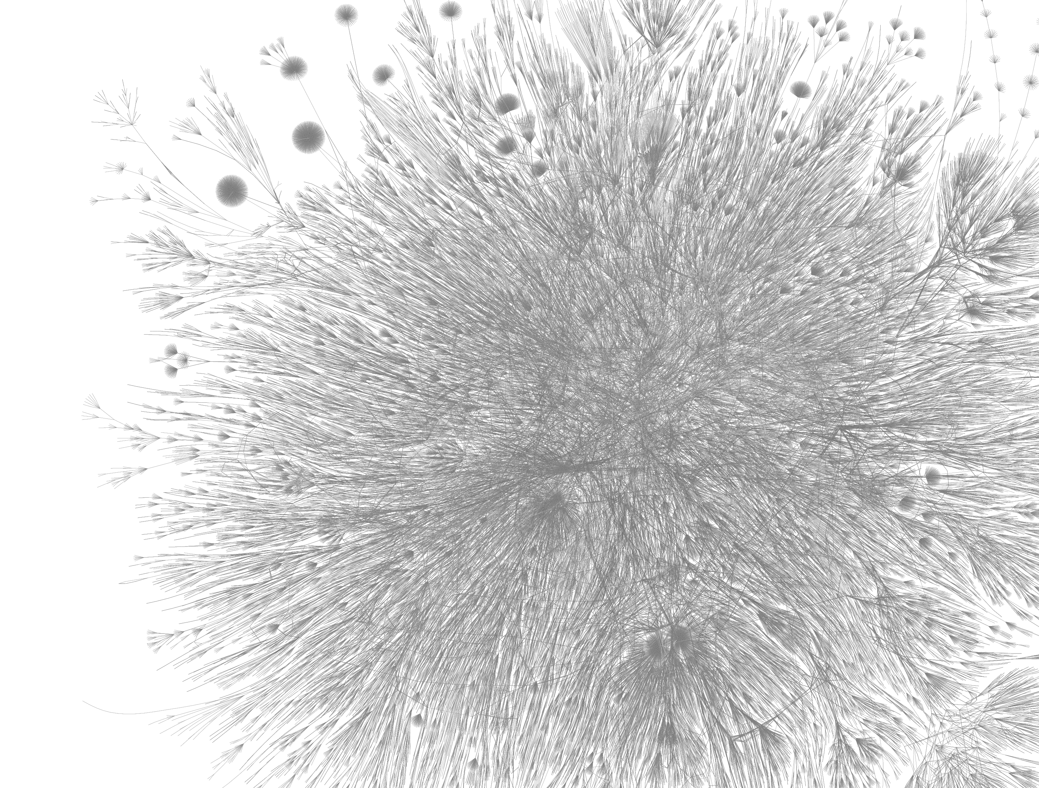
Challenges of Extremely Large Graphs
Chinese web graph from Sogou search engine
273 billion webpages (vertices)
12 trillion links (edges)
137 TB on-disk storage (compressed)
Massive amount of random data access
Low compute-to-memory-access ratio
Power-law data distribution
Notes:
Let’s see an example of an extremely large graph. This is a chinese web graph from Sogou search engine. It has 273 billion webpages and 12 trillion links, taking 137TB on disk.
Processing graph at such un'precedented scale brings specific new challenges.
First, it involves massive amount of random data accesses.
Second, low compute to memory access ratio, compared conventianal HPC application. This problem is more severe at large execution scale, and extend to massive scale of random point-to-point message passing.
Finally, real graphs are not balanced. They often have power-law degree distribution, with a small subset of vertices have very high degrees. This also gets worse when graphs grow larger.
Those are big scale challenges from the application side.

Slide 33
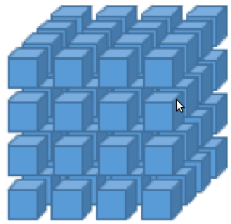
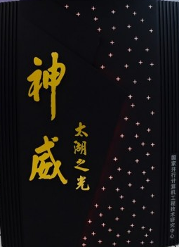
Sunway TaihuLight: Opportunities and Challenges
125 PFLOPS peak performance
1.3 PB main memory, with 5,591 TB/s bandwidth
70 TB/s network bisection bandwidth
Reliable external data access, 288 GB/s IO bandwidth
rack 1
rack 2
…
rack 40
CPE Cluster, 64 cores
DRAM
DRAM
Core Group 1
Core Group 2
CPE Cluster
MC
MC
CPE Cluster
MPE
MPE
Core Group 3
NOC
Core Group 4
CPE Cluster
MPE
MPE
CPE Cluster
…
MC
MC
CPE with SPM
Register Buses
(vertical & horizontal)
DRAM
DRAM
TaihuLight Top500 ranking: #3 (2018 Nov), #1 (2016, 2017)
Handling of huge number of messages among 40,960 nodes
Complex workload to map to its heterogeneous processing units
Irregular data flow to be scheduled in regular accelerator cores
Notes:
Now let’s look at big scale challenges from the system side. To be frank, Supercomputers are not designed for solving graph problems.
For example, our platform, Sunway TaihuLight is such an HPC machine, who had been leading the Top500 list for two years, and became the 3rd this week. It has over 40 thousand nodes, with heterogeneous architecture employing accelerator cores.
It does offer advantages for extremely large graph computing problem, with its [outstanding] aggregate throughput for computation, memory access, network communication.
On the other hand, Sunway TaihuLight brings significant challenges, including handling of huge number of messages among 40 thousand nodes, complex workload to map to its heterogeneous processing units, and the irregular data flow to be scheduled on its regular grid of accelerator cores.
In this talk, we present the key solutions we developed to address these specific challenges.

Slide 34
Shentu – Designed for Extreme Scale Graph
largest graph processing run ever documented
Better
Better
Better
Notes:
To give an overview of the relative capability and performance of these systems, with x axis marking graph size in number of edges, and y axis marking single-iteration pagerank processing time, in log scale.
We select those that can process at least trillion-edge graphs, and plot their capability and performance.
Our system, Shentu, on the other hand, can process orders of ‘magnitude larger graphs, in orders of magnitude shorter time. In particular, it finishes one pagerank iteration of a 70 trillion-edge graph in half a minute. To our best knowledge, Shentu completes the largest graph processing task ever documented, and is the first general-purpose graph framework targeting extreme-scale heterogeneous architecture.

Slide 35
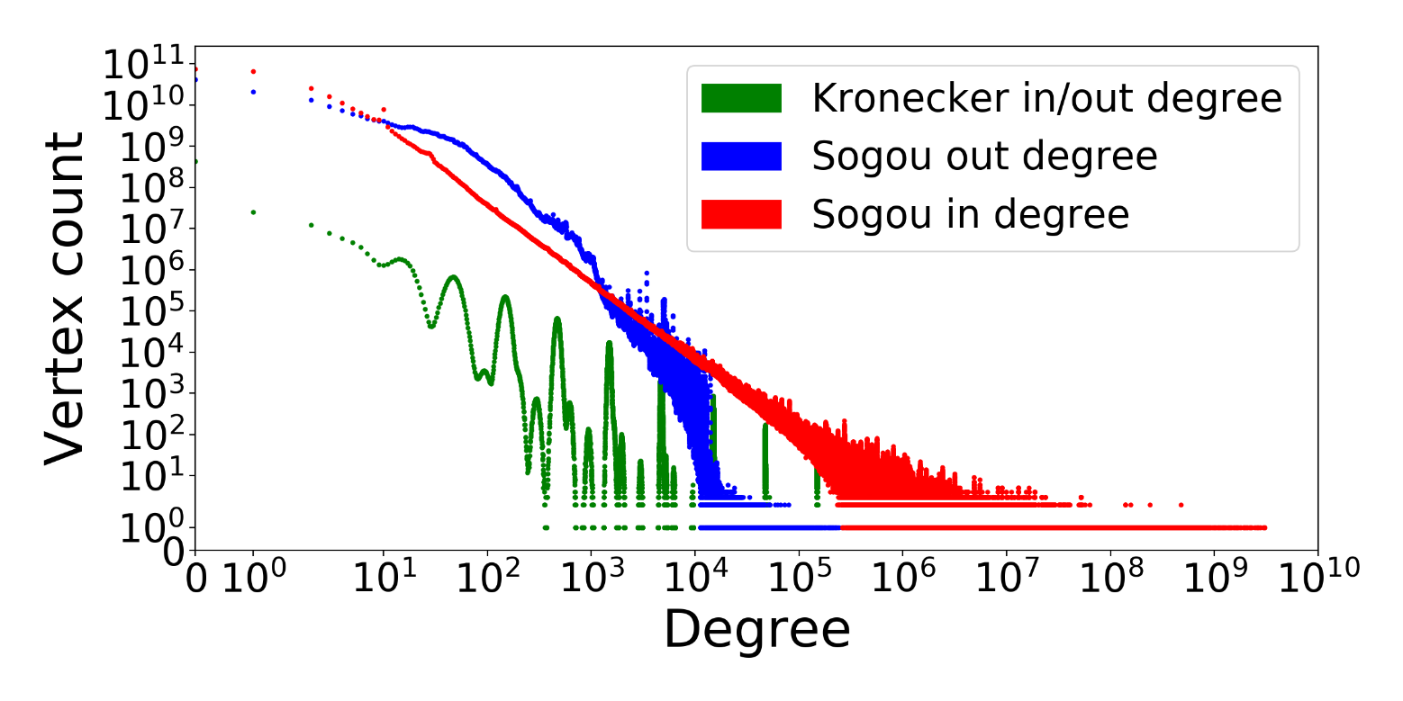
Problem 1: Severe Load Imbalance
MAX: 3.0 billion
AVG: 45
MAX: 47.6 million
AVG: 16
MAX: 381 thousand
AVG: 45
Power-law degree distribution
Asymmetric in/out degree distribution
Real-world graph has higher skew
Notes:
Now we discuss several problems incurred by extreme-scale graph processing and how we handle them.
The first is the severe level of load imbalance. In the figure, the y axis gives the vertex count with different degrees along the x-axis.
This is the distribution given by kronecker, the official synthetic graph generator used by Graph500. And this is what we see with Sogou, a real-world web graph. Unlike the synthetic graph, the real-world graph here has very different distribution in in-degree and out-degree, with out-degree relatively even and in-degree highly skewed. The real world graph also has longer tail in its in-degree distribution: while the average in-degree is 45, the max reaches 3 billion!
Such skewness creates problems not seen by smaller-scale systems. For example, the largest "super vertices" takes much more memory to hold than a single compute node, and they will have tons of interaction with all other nodes.

Slide 36
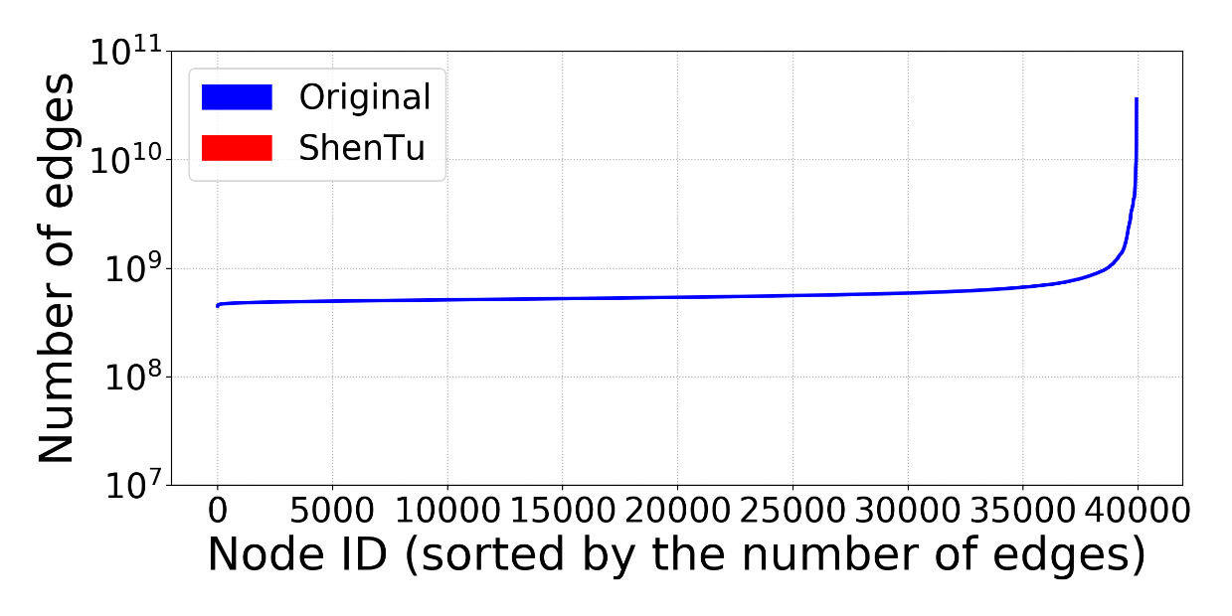
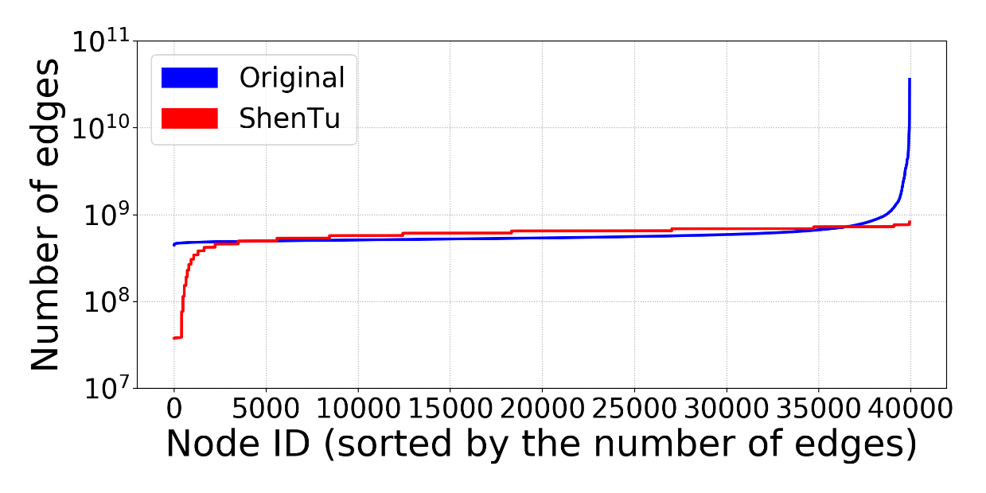
Solution 1: Degree Aware Messaging
High-out
Regular
a
d
f
a
d
f
g
b
x
X
x
b
X
Y
c
y
e
y
Y
c
e
g
High-in
Global mirroring of high-degree vertices
Simplifying mirroring with the “all-or-none” replication policy (high-degree vertices are replicated to all compute nodes),
MAX: 36 billion
Better load balance
Fewer inter-node messages
Leveraging collective communication
MAX: 825 million
44x load-balance improvement
Notes:
Based on these observations, we perform degree aware messaging. More specifically, we put all vertices into three categories: high-in, high-out, and regular, and differentiate their handling. Because of the asymmetry noted before, we adopt different thresholds for in and out degrees.
We replicate high-in or high-out vertices on ALL compute nodes. The local mirror of such high-degree vertices each takes care of a partition of their edges and communicates with their peers as proxies. This solution has multi-fold benefits.
First, we distribute these high-degree vertices and their workload to all nodes. The blue distribution here shows the number of edges handled by each compute node before the high-degree node mirroring, while the red one is after. We can see that degree aware messaging has 44 load-balance improvement.
Second, with the local mirror of high-degree vertices combining updates, we dramatically reduce the number of messages.
Finally, such global replication takes advantage of collective communication mechanisms, highly optimized on supercomputers.
For the regular vertices
we perform no message combining, as these regular vertices talk to a very small set of neighbors, so it’s not worthwhile to pay the hashing or memory cost to implement message combining.

Slide 37
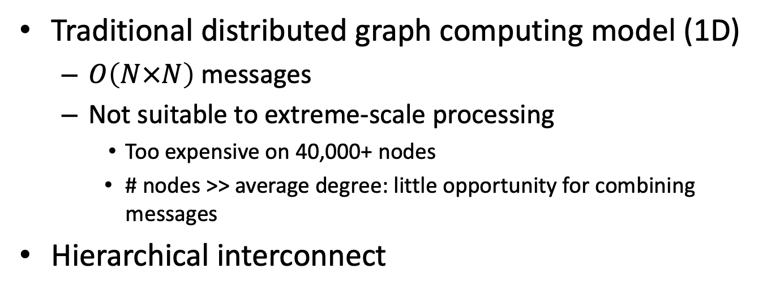
Problem 2a: Too Many Small Messages
Traditional distributed graph computing model (1D)
$O\left(N×N\right)$ messages
Not suitable to extreme-scale processing
Too expensive on 40,000+ nodes
# nodes >> average degree: little opportunity for combining messages
Hierarchical interconnect
Central switches
4:1 oversubscription
Supernode of 256 nodes
Supernode of 256 nodes
Supernode switches
Supernode switches
… 160 supernodes …
…
…
Notes:
As ShenTu adopt 1D data partition, each node will send messages to all the other nodes, to update vertices along edges.
This mechanism doesn’t really work at our target scale.
First, 40,000 nodes performing pairwise updates is not efficient.
Second, at such scale, the number of compute nodes is much larger than the average degree, meaning that there is little chance to combine messages. result in a great number of small messages.
That is the challenge from the application side. From the system side, state of the art supercomputers have hierarchical network interconnection. With TaihuLight, for example, the per-node bandwidth reduces by a factor of 4, once outside of a supernode. That means we have much higher communication bandwidth within a supernode.

Slide 38
Solution 2a: Supernode Routing
Rather than direct messaging, communication is divided into two stages
1
1
1
2
2
2
3
3
3
1
1
1
2
2
2
3
3
3
1
1
1
2
2
2
3
3
3
4
4
4
5
5
5
6
6
6
4
4
4
5
5
5
6
6
6
4
4
4
5
5
5
6
6
6
Node
7
7
7
8
8
8
9
9
9
7
7
7
8
8
8
9
9
9
7
7
7
8
8
8
9
9
9
Supernode
Message
Notes:
We solve these problems with supernode routing, rather than direct messaging, communication is divided into two stages.
Let’s look at this toy example with 9 compute nodes on 3 supernodes. Here each dot represents a message, color-coded to show the destination node it needs to update.

Slide 39
Solution 2a: Supernode Routing
Stage 1
Messages grouped by destination supernodes
Combined messages sent to relay node in destination supernode
1
1
1
2
2
2
3
3
3
1
1
1
2
2
2
3
3
3
1
1
1
2
2
2
3
3
3
4
4
4
5
5
5
6
6
6
4
4
4
5
5
5
6
6
6
4
4
4
5
5
5
6
6
6
7
7
7
8
8
8
9
9
9
7
7
7
8
8
8
9
9
9
7
7
7
8
8
8
9
9
9
Notes:
In the first stage, each source node grouped its outgoing messages by destination supernode, and sends the combined message to a relay node in each destination supernode.

Slide 40
Solution 2a: Supernode Routing
Stage 1
Messages grouped by destination supernodes
Combined messages sent to relay node in destination supernode
1
1
1
2
2
2
3
3
3
4
4
4
5
5
5
6
6
6
7
7
7
8
8
8
9
9
9
1
1
1
2
2
2
3
3
3
4
4
4
5
5
5
6
6
6
7
7
7
8
8
8
9
9
9
1
1
1
2
2
2
3
3
3
4
4
4
5
5
5
6
6
6
7
7
7
8
8
8
9
9
9

Slide 41
Solution 2a: Supernode Routing
Stage 1
Messages grouped by destination supernodes
Combined messages sent to relay node in destination supernode
Stage 2
Messages grouped by destination nodes within same supernode
Combined messages sent to final destination node
1
1
1
2
2
2
3
3
3
4
4
4
5
5
5
6
6
6
7
7
7
8
8
8
9
9
9
1
1
1
2
2
2
3
3
3
4
4
4
5
5
5
6
6
6
7
7
7
8
8
8
9
9
9
1
1
1
2
2
2
3
3
3
4
4
4
5
5
5
6
6
6
7
7
7
8
8
8
9
9
9
Notes:
In the second stage, each node processes its incoming messages, relaying the messages to the destinaiton node within the same supernode.

Slide 42
Solution 2a: Supernode Routing
Stage 1
Messages grouped by destination supernodes
Combined messages sent to relay node in destination supernode
Stage 2
Messages grouped by destination nodes within same supernode
Combined messages sent to final destination node
1
2
3
1
2
3
1
2
3
4
5
6
4
5
6
4
5
6
7
8
9
7
8
9
7
8
9
1
2
3
1
2
3
1
2
3
4
5
6
4
5
6
4
5
6
7
8
9
7
8
9
7
8
9
1
2
3
1
2
3
1
2
3
4
5
6
4
5
6
4
5
6
7
8
9
7
8
9
7
8
9
Notes:
Note that all nodes will act as source, destination, and relay nodes. With this approach, we dramatically reduce the number of messages, especially those across supernodes, leaving more fine-grained message passing to the faster network within each supernode.

Slide 43
Solution 2a: Supernode Routing
1
2
3
1
2
3
1
2
3
4
5
6
4
5
6
4
5
6
7
8
9
7
8
9
7
8
9
…
……
…
160 supernodes, 256 nodes in each
1
2
3
1
2
3
1
2
3
4
5
6
4
5
6
4
5
6
Direct update: 160*256 - 1 small messages
7
8
9
7
8
9
7
8
9
1
2
3
1
2
3
1
2
3
4
5
6
4
5
6
4
5
6
Supernode routing: 160 +256 - 2 large messages
7
8
9
7
8
9
7
8
9
Notes:
Specifically, with our target system, there are 160 supernodes, each containing 256 compute nodes. If we use direct update approach, each source node will generate 160x256 small messages, while our 2-stage supernode routing will produce only 160+256 larger messages. Result in low network communication efficiency.

Slide 44
Problem 2b: Irregularity in Network Topology
Failed nodes forbid direct source-relay mapping
Source supernode
Source node
Destination supernode
Stochastic assignment: load balancing in destination supernode
Notes:
Our 2-stage supernode routing scheme is designed to be topology aware.
One practical problem we run into, however, is that not all compute nodes are allocated to the job. Even with full-machine runs, there could be small holes in allocation, e.g., due to node failures.
Ideally, when doing supernode routing, we could easily use the corresponding node in each supernode as a relay node. Suppose I am the 2nd compute node in a supernode, then the 2nd node in each supernode will be the relay node that I talk to in that supernode.
With a small number of compute node missing, we can’t really do that.
To achieve balanced relay load, and also retain the benefit of message combination, we use a stochastic assignment algorithm that adjusts the boundary of relay load partitioning.

Slide 45
Solution 2b: Topology-aware Super-node Relaying
Failed nodes forbid direct source-relay mapping
Source supernode
Source node
Destination supernode
Stochastic assignment: load balancing in destination supernode
Notes:
In this example, there are 6 compute nodes in the source supernode, and only 5 in the destination.

Slide 46
Solution 2b: Topology-aware Super-node Relaying
Failed nodes forbid direct source-relay mapping
Source supernode
Source node
Destination supernode
1/5 goes left
4/5 goes right
Stochastic assignment: load balancing in destination supernode
Notes:
We partition the capacity of the 5 relaying nodes into 6 virtual nodes, to match the 6 nodes in the source supernode. In this example, the second source node will probabilistically distribute its messages between destination node1 and node 2. This way, the load is balanced, while minimizing the number of relay nodes each source node talks to.

Slide 47
Problem 3: Heterogeneous Architecture
MPE (Management Processing Element)
General-purpose processor
Low memory bandwidth
CPE (Compute Processing Element)
High memory bandwidth
Limited functionality
Shared memory between MPE and CPE
1 node, 4 core groups, 260 cores
CPE cluster, 64 cores
DRAM, 28.9 GB/s
DRAM, 28.9 GB/s
Core group 1
Core group 2
CPE cluster
MC
MC
CPE cluster
MPE
MPE
Core group 3
NOC
Core group 4
MPE
MPE
CPE cluster
CPE cluster
MC
MC
DRAM, 28.9 GB/s
DRAM, 28.9 GB/s
Requires careful task mapping and coordination
Notes:
The final problem is the heterogeneous architecture of TaihuLight’s home-made processor.
Let’s zoom into a compute node, where we have 4 core groups, each with one MPE and 64 CPEs.
MPE is the general-purpose element, with full control flow and IO capability, but low memory bandwidth.
CPE is the co-processor element. The 64-core CPE cluster offers considerable hardware parallelism and high aggregated memory bandwidth. Meanwhile, CPE has limited functionality and is unable to handle communication.
The processor has fusion architecture, meaning shared memory between MPE and CPE
So, we need careful task mapping and coordination

Slide 48
Solution 3a: Heterogeneous Task Mapping
Generate & Sort
CPE 1
1. Generate & Sort
C1
Send
MPE 1
M1
2. Send
Receive
MPE 2
Relay
CPE 2
Send
MPE 3
4. Relay
Receive
MPE 4
3. Receive
C2
Coarse Sort
CPE 4
M2
6. Receive
8. Sort & Update
Sort & Update
CPE 3
M3
C3
M4
C4
5. Send
7. Coarse Sort
Notes:
To this end, Shentu maps each module of its pipeline to the specific MPE or CPE cluster according to their workload characteristics.
Among them, the modules ‘generate and sort’, ‘relay’, ‘coarse sort’, and ‘sort and update’ contain a lot of memory accesses and are memory bandwidth intensive, so we map them to the CPE clusters.
Meanwhile, the send and receive modules require MPI communication so should be mapped onto MPE.
In addition, we designed the modules to occupy all MPEs and CPEs in a balanced way. Recall that each compute node plays the source, relay, and destination role in Shentu’s 2-stage supernode routing. Within a compute node, the first core group performs the source node functionality, generating outgoing messages and sort them. The 2nd core group performs relay functionality, while the 3rd and 4th groups perform destination node functionality, receiving and sorting incoming messages, and updating vertices accordingly.

Slide 49

Solution 3b: CPE Cluster On-chip Sorting
Generate & Sort
Unsorted data
Sorted data
CPE cluster
Send
Receive
Relay
Send
…
Receive
Coarse Sort
On-chip sorting
Producer
Router
Consumer
Sort & Update
Notes:
Shentu performs sorting as a central computation task shared by all its CPE modules, repeatedly bucketing messages by their destination.
We design a specific on-chip sorting mechanism to enable efficient sorting within each CPE cluster.
If sorting is assigned to MPE, its processing is bound by the memory bandwidth and reaches only 1.09GB/s.
However, the CPEs lack efficient synchronization. So if we implement naïve parallel sorting with atomic operations for synchronization, we get a sorting bandwidth of 0.42GB/s, even much lower than the single MPE’s performance.
Instead, Shentu performs another level of heterogeneous mapping within the CPE cluster, to utilize its fast [on-chip] register communication, which is available row wise and column wise only. It builds a sorting network, with the first group of 16 cores reading unordered data from memory, distributing them to the next 16 cores by value. This second group in turn performs another round of shuffling to the 3rd group of 16 cores, who write sorted data back to memory. No synchronization is needed in this 2-pass shuffling process, bringing a sorting bandwidth of 9.8GB/s.

Slide 50
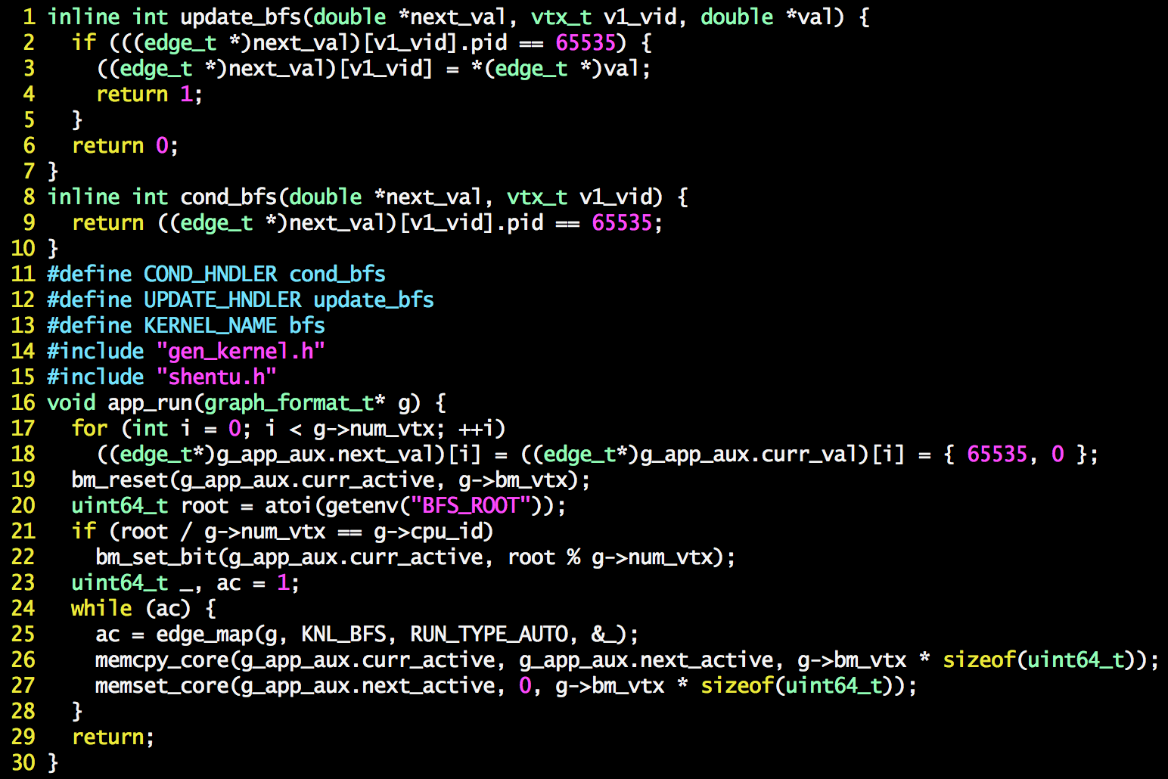
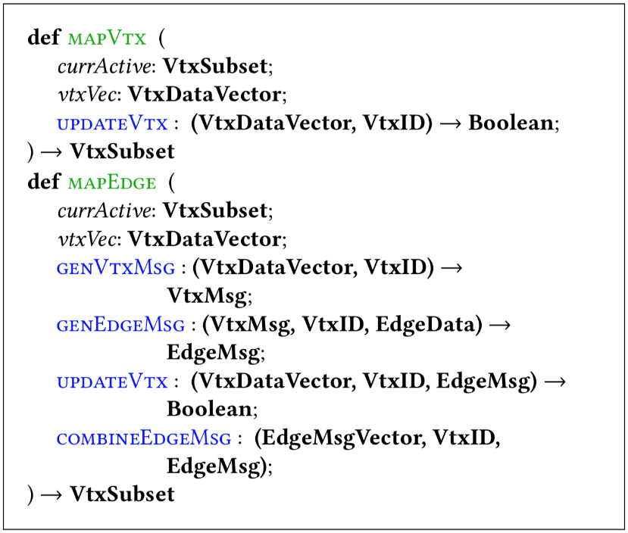
Programming Interface
End-to-end optimization
=> 22,000 Shentu LoC
Present standard graph APIs to users
Graph500 specific BFS implementation [1]:
> 9,000 LoC
Shentu: 30 LoC for BFS
[1] Heng Lin et al, IPDPS ‘2017, Scalable graph traversal on Sunway TaihuLight with ten million cores
Notes:
In addition, we proposed quite a few other techniques for end-to-end graph processing performance optimization, including direction optimization, fast graph loading, and randomized vertex partitioning. Please see our paper for details. All these led to 22,000 lines of Shentu codes in C.
Meanwhile, as a general-purpose graph framework, Shentu hides its complexity from users with the simple, standard graph APIs. For example, implementing BFS with such APIs takes only 30 lines of code.
In contrast, a previous Graph500 specific BFS implementation on TaihuLight has more than 9,000 lines of code.

Slide 51

Evaluation Methodology: What to Measure
Graph500 suggests TEPS (Traversed Edges Per Second)
Example: optimized BFS with scale-38 Kronecker graph
4.4 billion edges traversed
195 million edges accessed (4.4%)
We suggest PEPS (Processed Edges Per Second)
Reflects actual processing ability, less implementation-dependent
Traversed $≠$ Actually accessed
Notes:
Next, evaluation.
First we need a suitable metric.
Graph500 suggests TEPS, or Traversed Edges Per Second. However, depending on implementation, the number of traversed edges may be quite different from the one actually accessed. For example, an optimized BFS using scale-38 Kronecker graph traverses 4.4 billion edges, but only access around 200 million edges, under 5% of those traversed.
Instead, we propose PEPS, processed edges per second, which measures the speed of processing edges, and corresponds directly to the amount of work required by the problem.

Slide 52
Experiment Setup
Graph algorithms implemented
BFS (Breadth First Search)
PR (PageRank)
WCC (Weakly Connected Component)
BC (Betweenness Centrality)
K-Core - implemented, but skipped large-scale experiments
Input graphs: Both synthetic graphs and real graphs
Synthetic: Kronecker synthetic graph generator, average degree 16, (A,B,C,D) = (0.57, 0.19, 0.19, 0.05)
Real-world: Sogou web graph, Clueweb, Hyperlink, etc.
Notes:
For evaluation, we implemented these five graph algorithms and tested with both synthetic and real-world graphs. For Kcore, we implemented the algorithm but found it to be too slow due to its frequent barriers, therefore we skipped the largest scale tests.

Slide 53
Weak Scaling
Scale 40, or
2⁴⁰ vertices
2⁴⁴ edges
Scale 35
Notes:
First we show weak scaling results, where we increase the graph size from scale 35 on 1248 nodes to scale 40 on the full system.
Due to node availability, our largest run used 38,656 nodes though ShenTu scales to the full system of 40,960 nodes.
the x axis shows the system scale, and the y axis shows the aggregate GPEPS.
As the graph shows, all three algorithms, BFS. WCC, and PageRank achieve pretty good weak scaling.

Slide 54
Strong Scaling
Scale 36
Scale 36, or
2³⁶ vertices
2⁴⁰ edges
Notes:
For strong scaling, we have the same x and y axis definition, with the graph scale fixed at 36.
We can see that the scaling slows down beyond 5000 nodes, due to the growing network synchronization and streaming overhead.

Slide 55
Summary of Experiments and Results
Aggregated GPEPS
 | #Vtx | #Edge | Size | #Node | IO cost(s) | PR | BFS | WCC | BC | KCore | Net. Usage
twitter | 41.6m | 1.4b | 16GB | 16 | 37.2 | 0.75 | 0.36 | 0.54 | 0.30 | 0.01 | 28.1%
uk-2007 | 105.8m | 3.7b | 41GB | 64 | 28.9 | 3.99 | 3.36 | 3.97 | 0.87 | 0.13 | 28.1%
clueweb | 978.4m | 42.5b | 476GB | 100 | 119.4 | 5.04 | 2.47 | 4.79 | 1.23 | 0.41 | 47.4%
uk-2014 | 747.8m | 47.6b | 532GB | 100 | 132.7 | 4.67 | 2.06 | 3.81 | 0.35 | 0.32 | 47.1%
weibo | 349.9m | 42.4b | 474GB | 100 | 121.3 | 8.22 | 2.56 | 7.15 | 4.77 | 0.72 | 40.8%
hyberlink | 3.5b | 128.7b | 1.5TB | 256 | 243.0 | 17.20 | 3.68 | 14.49 | 0.32 | 0.26 | 60.1%
sogou | 271.8b | 12253.9b | 136.9TB | 38656 | 2130.6 | 1443.4 | 30.8 | 224.4 |  |  | 18.8%
34.rmat | 17.1b | 274.8b | 3.3TB | 1024 | - | 83.0 | 34.5 | 77.7 | 44.8 | 0.25 | 29.2%
34.erdos | 17.1b | 274.8b | 3.3TB | 1024 | - | 52.5 | 48.8 | 51.3 | 40.9 | 18.60 | 63.7%
34.kron | 17.1b | 274.8b | 3.3TB | 1024 | - | 72.8 | 18.2 | 62.3 | 43.1 | 0.82 | 40.2%
42.kron | 4398.0b | 70368.7b | 844.4TB | 38656 | - | 1984.8 | 773.9 | 1956.0 |  |  | 40.0%
 | #Vtx | #Edge | Size | #Node | IO cost(s) | PR | BFS | WCC | BC | KCore | Net. Usage
twitter | 41.6m | 1.4b | 16GB | 16 | 37.2 | 0.75 | 0.36 | 0.54 | 0.30 | 0.01 | 28.1%
uk-2007 | 105.8m | 3.7b | 41GB | 64 | 28.9 | 3.99 | 3.36 | 3.97 | 0.87 | 0.13 | 28.1%
clueweb | 978.4m | 42.5b | 476GB | 100 | 119.4 | 5.04 | 2.47 | 4.79 | 1.23 | 0.41 | 47.4%
uk-2014 | 747.8m | 47.6b | 532GB | 100 | 132.7 | 4.67 | 2.06 | 3.81 | 0.35 | 0.32 | 47.1%
weibo | 349.9m | 42.4b | 474GB | 100 | 121.3 | 8.22 | 2.56 | 7.15 | 4.77 | 0.72 | 40.8%
hyberlink | 3.5b | 128.7b | 1.5TB | 256 | 243.0 | 17.20 | 3.68 | 14.49 | 0.32 | 0.26 | 60.1%
sogou | 271.8b | 12253.9b | 136.9TB | 38656 | 2130.6 | 1443.4 | 30.8 | 224.4 |  |  | 18.8%
34.rmat | 17.1b | 274.8b | 3.3TB | 1024 | - | 83.0 | 34.5 | 77.7 | 44.8 | 0.25 | 29.2%
34.erdos | 17.1b | 274.8b | 3.3TB | 1024 | - | 52.5 | 48.8 | 51.3 | 40.9 | 18.60 | 63.7%
34.kron | 17.1b | 274.8b | 3.3TB | 1024 | - | 72.8 | 18.2 | 62.3 | 43.1 | 0.82 | 40.2%
42.kron | 4398.0b | 70368.7b | 844.4TB | 38656 | - | 1984.8 | 773.9 | 1956.0 |  |  | 40.0%
27,366 iterations
Graph construction and application run memory utilization > 68.3%
9 iterations
Notes:
This table summarizes characteristics of the real-world and synthetic graphs we used, with performance in aggregate GPEPS running the 5 graph algorithms we implemented.
We highlight two largest tests, with the 12-trillion edge Sogou web graph, and 70-trillion edge Kronecker graph.
To make 70-trillion edge possible, ShenTu has a very high memory utilization in graph construction and application running, about 68.3%
The BFS result has large difference in GPEPS between sogou and Kronecker graph due to the real web graph contains long tails that dramatically increase its number of iterations, with the a lot of the vertices inactive in most of the processing.
Overall, the Shentu performance is pretty good. For example, we measure our performance as 8328 GTEPS, about 1/3 of the reported results from the Graph500 specific BFS implementation. However, note that Shentu is a general-purpose graph framework without algorithm-specific optimizations, such as vertex reordering, and get 1/3 of the performance using 30 lines of code.

Slide 56
Graph Processing
From one node to 40K nodes
Out of core
Shentu
SC’18
In
Mem
Single
Machine
Multiple
Machine

Slide 57
Graph mining

Slide 58
Graph Mining
Find given patterns in graph
Triangle, Clique
Count numbers or output all subgraphs
Frequent Subgraph Mining(FSM)
Some Figures of this page and following pages from:
*Daniel Mawhirter, Bo Wu: AutoMine: harmonizing high-level abstraction and high performance for graph mining. SOSP 2019

Slide 59
Triangle Counting

Slide 60
Triangle Counting is well studied
*

Slide 61
General cases are much more challenging

Slide 62
Think Like a Embedding(TLE)

Slide 63
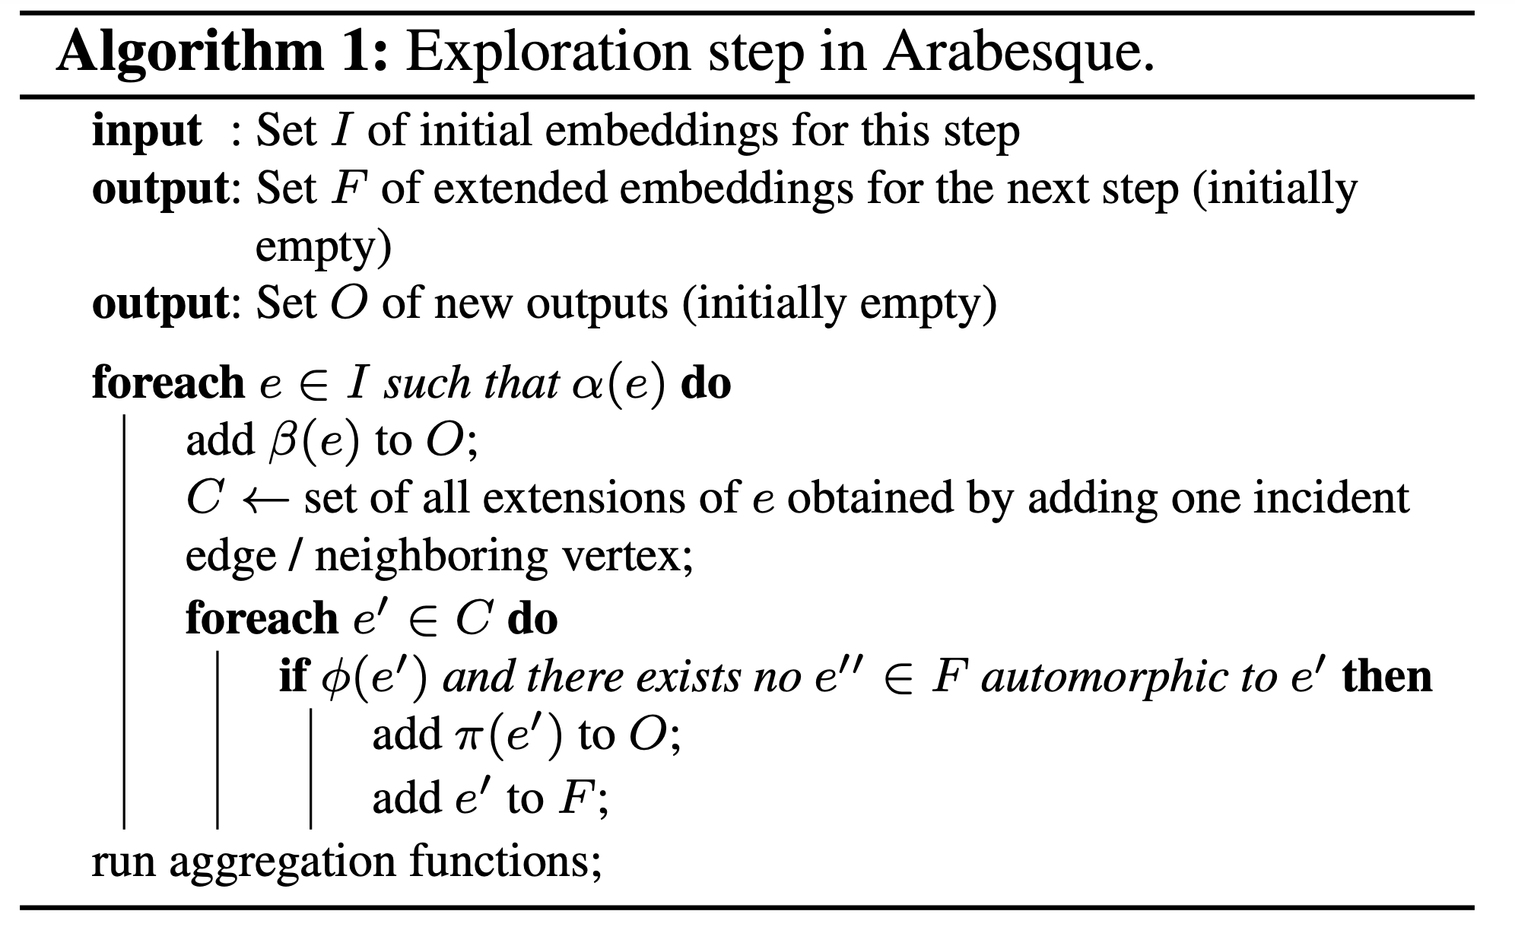

Slide 64
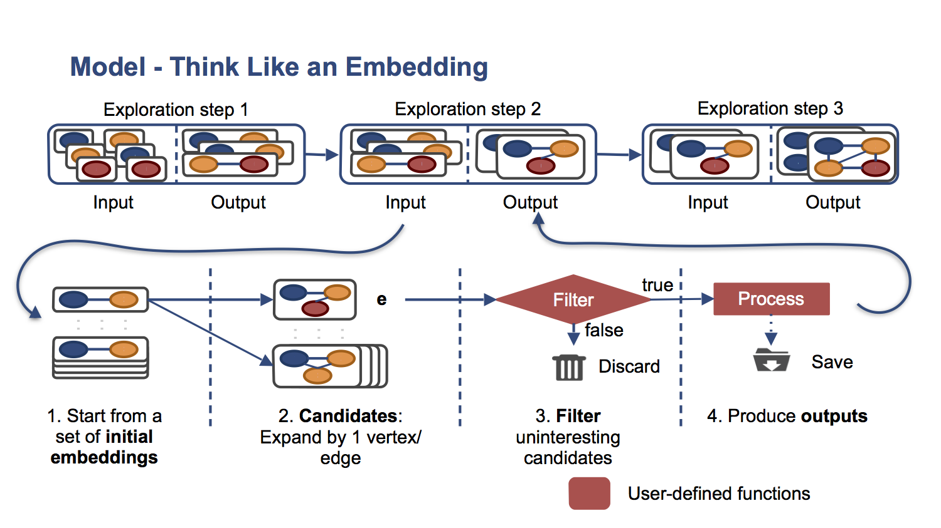
Arabesque: A TLE Graph Mining Engine
http://arabesque.qcri.org/user_guide.html

Slide 65
Problems of TLE
BFS style embedding extension
Huge intermediate states (exponentially increased with number of edges)

Slide 66
Automine*
DFS style embedding extension
to reduce intermediate states
*Daniel Mawhirter, Bo Wu: AutoMine: harmonizing high-level abstraction and high performance for graph mining. SOSP 2019

Slide 67
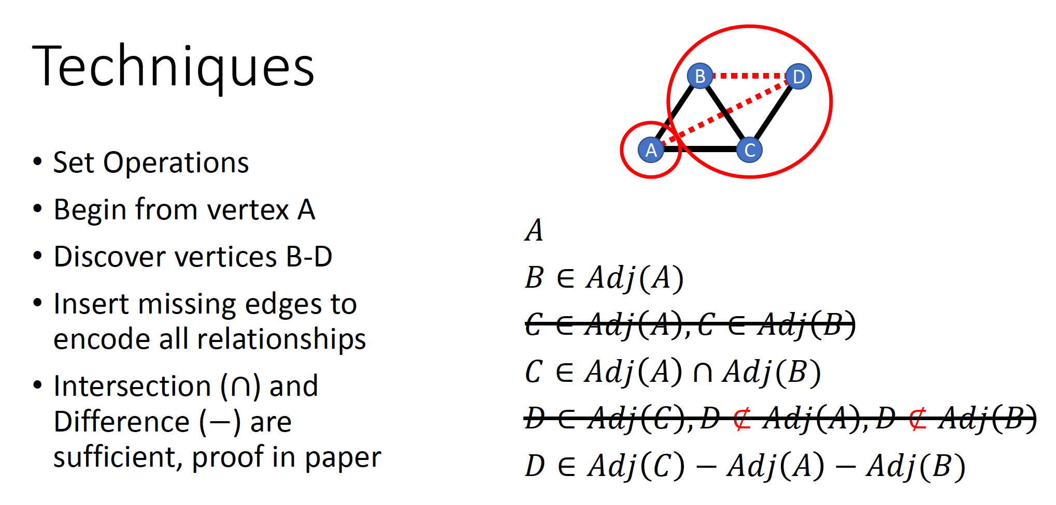

Slide 68
Summary
Graph is a general form of irregular data structure
We have discussed graph algorithms on immutable graphs
Graph processing : Vertex centric processing
Single machine vs Distributed
In memory vs out of core
Graph mining
More compute intensive, requires large memory to maintain state
We have not discussed if graph is changing
Graph databases
Graph streaming systems

Slide 69
Thanks

